Slide 1
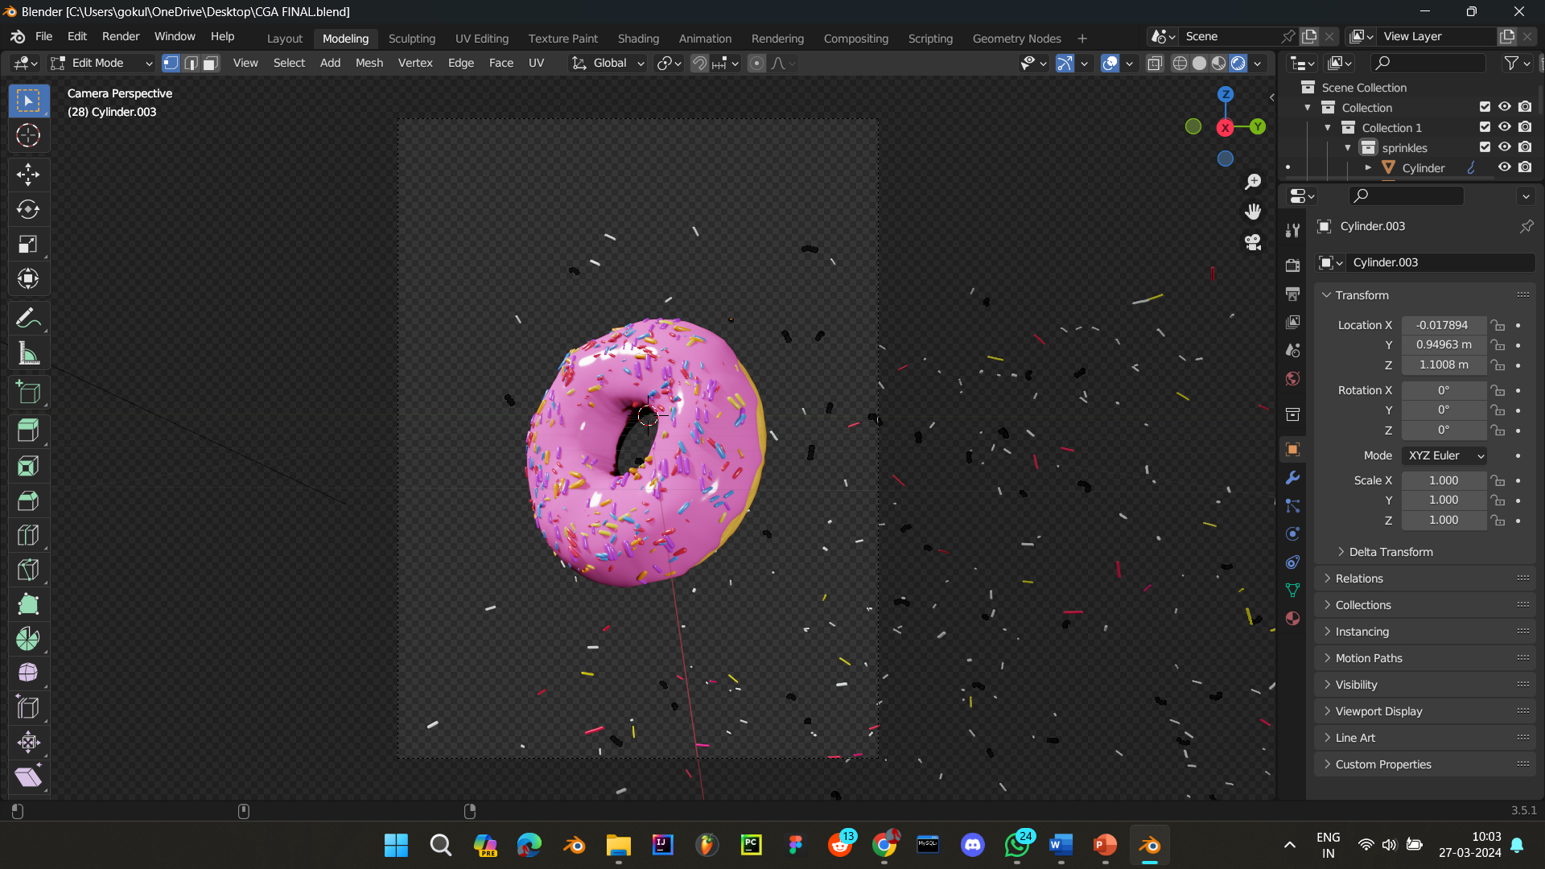
Blender 3.5 in Animation Production Overview
Presented by: S Gokul (RA2211003011996)
J D Muthumani (RA2211003012002)
R Lokeshwaran (RA2211003012018)

Slide 2
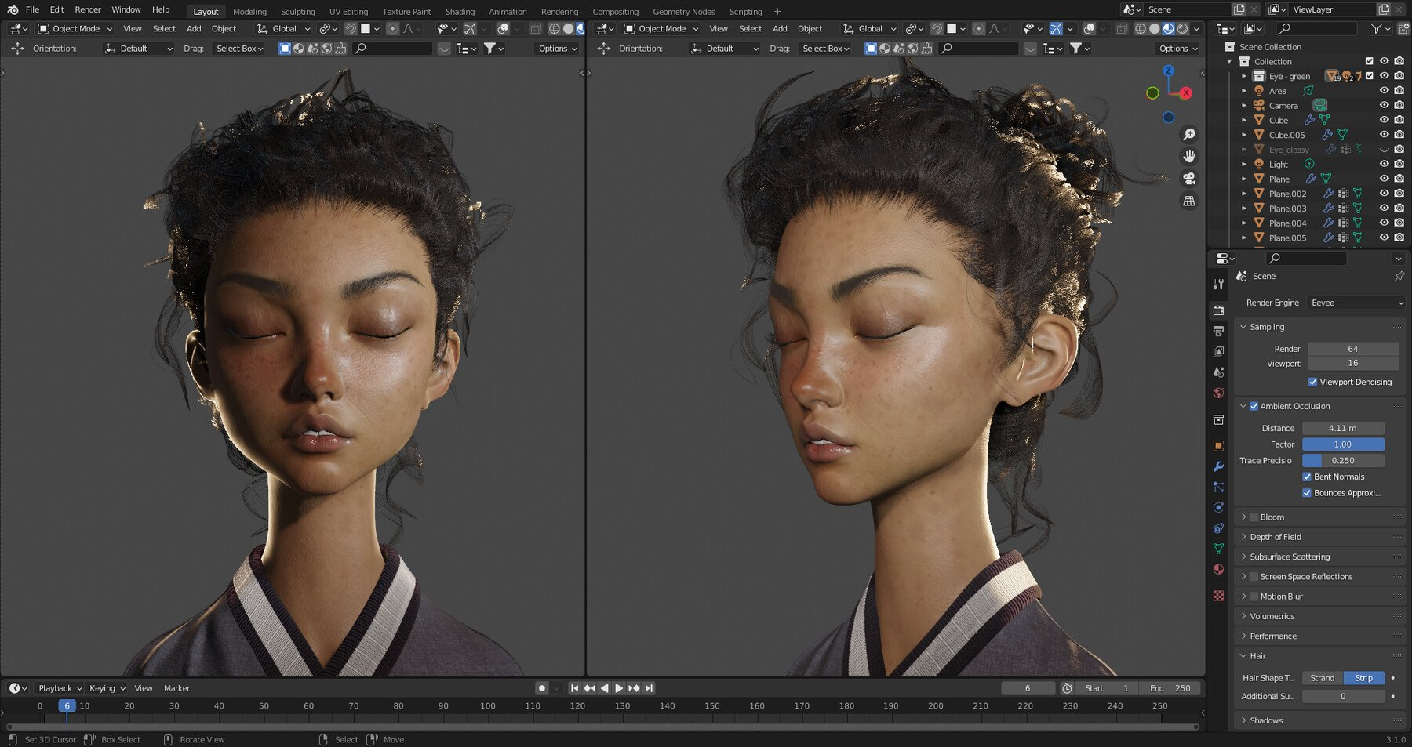
Introduction:
▶️Blender 3.5: An open-source 3D creation software suite renowned for its comprehensive features spanning the entire animation production pipeline.
▶️ Importance of Blender 3.5 in animation production: Its accessibility, versatility, and powerful toolset make it a popular choice for animators across various industries.

Slide 3
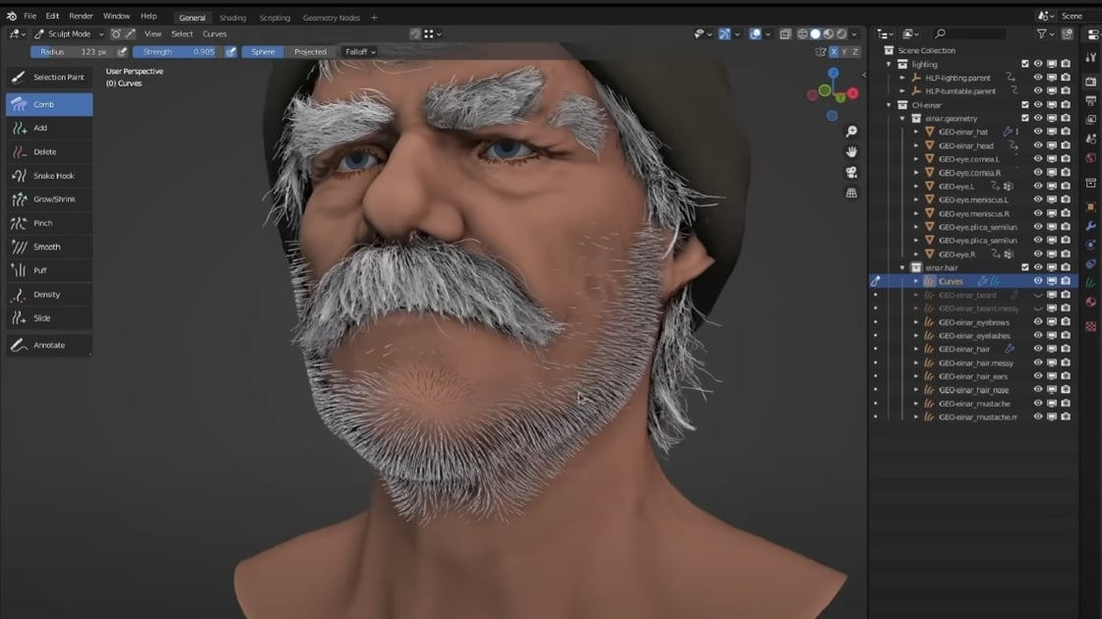
Research Objectives:
▶️ Objective: Examine the impact of Blender 3.5 on animation production processes, including creativity, efficiency, and overall quality.
▶️ Objective: Evaluate the usability and user experience of Blender 3.5 for animation creation.
▶️ Objective: Assess the performance and scalability of Blender 3.5 in animation production workflows.

Slide 4
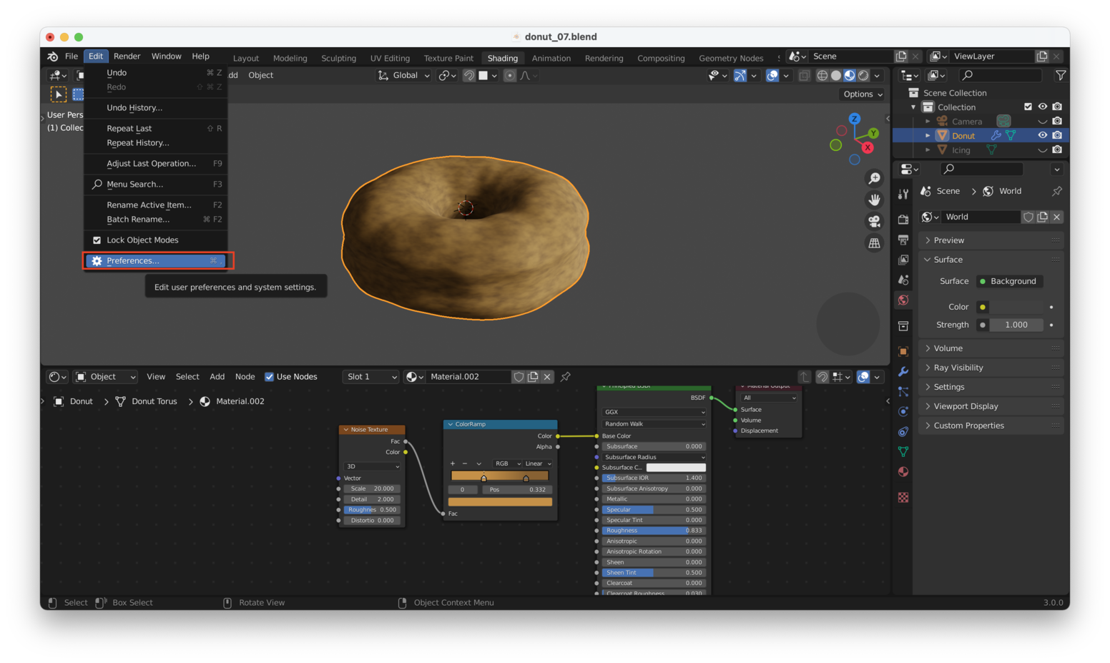
Methodology:
▶️ Literature review: Gathered existing knowledge, publications, and resources related to Blender 3.5, animation creation, and industry trends.
▶️ Analysis of existing projects: Studied animation projects created with Blender 3.5, both publicly available and provided by participating studios.

Slide 5

Features of Blender 3.5:
▶️ Comprehensive toolset: Blender 3.5 offers a wide range of features including modeling, rigging, animation, simulation, rendering, compositing, and motion tracking.
▶️ Comparative analysis: Compared Blender 3.5 with previous versions and other animation production tools in terms of features and capabilities.

Slide 6
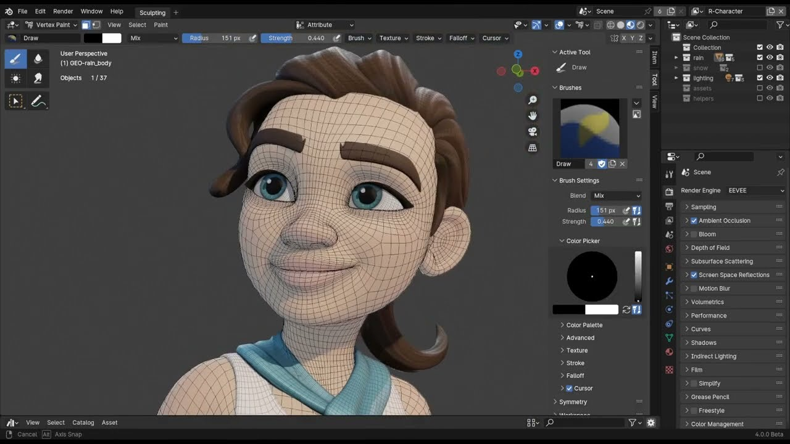
Usability of Blender 3.5:
▶️User-friendly interface: Blender 3.5 boasts an intuitive interface that facilitates seamless navigation and workflow.
▶️ Workflow enhancements: Highlighted improvements in workflow efficiency and user experience.

Slide 7
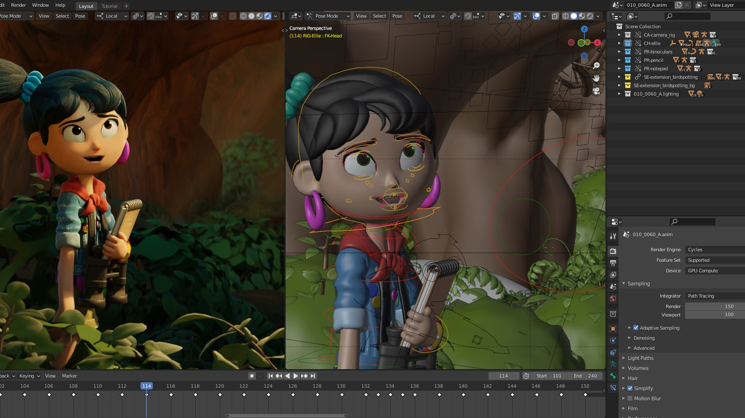
Performance Evaluation:
▶️ Hardware compatibility: Assessed Blender 3.5's performance across different hardware configurations and scene complexities.
▶️ Benchmarking: Compared Blender 3.5's performance with other animation production tools in terms of rendering speed and resource utilization.

Slide 8
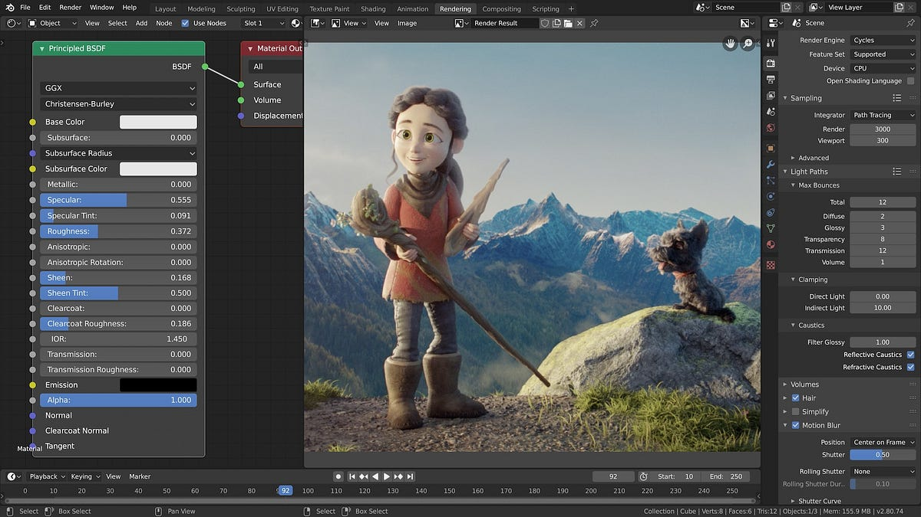
Impact of Blender 3.5:
▶️ Enhanced creativity: Blender 3.5 empowers animators to unleash their creativity and bring their ideas to life with its comprehensive feature set.
▶️ High-quality output: Blender 3.5 enables animators to produce high-quality animations with realistic visuals and immersive storytelling experiences.

Slide 9
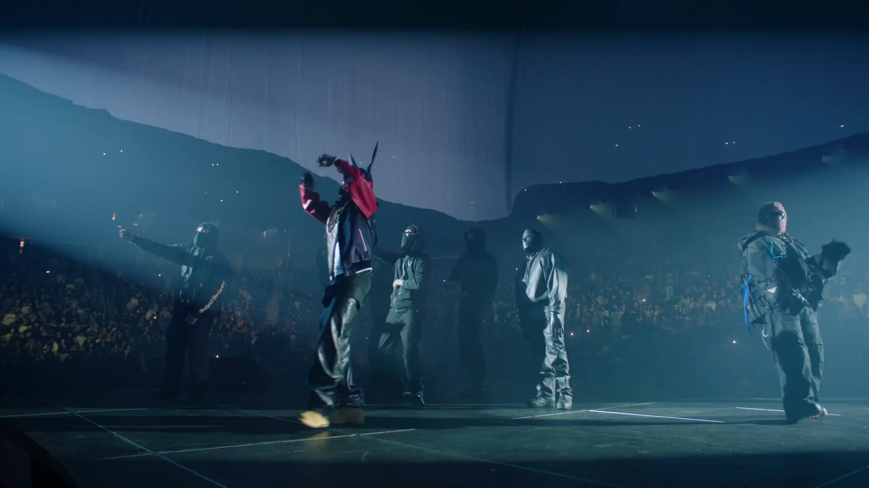
Advantages and disadvantages of Blender 3.5:
Advantages of Blender:
Open-Source & Free
Versatile Toolset
Active Community & Resources
Frequent Updates
Cross-Platform Compatibility
Powerful Rendering Engine
Customization & Extensibility
Disadvantages of Blender:
Steep Learning Curve
Performance Issues
Limited Industry Adoption
Lack of Integrated Plugins
Documentation Gaps

Slide 10
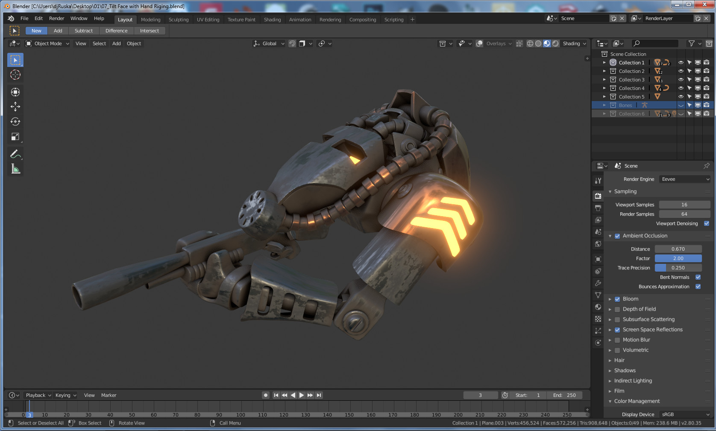
Conclusion:
▶️ Summary of findings: Presented key findings from the case study, including the impact of Blender 3.5 on animation production processes, usability, and performance.
▶️ Recommendations: Provided recommendations for optimizing the use of Blender 3.5 in animation production workflows and suggested areas for future development.

